Slide 1
Site Code | Config. Number | Surveyors Initials
Site Name |  | Survey Date
Approximate Low Water Line
Approximate High Water Line

Slide 2
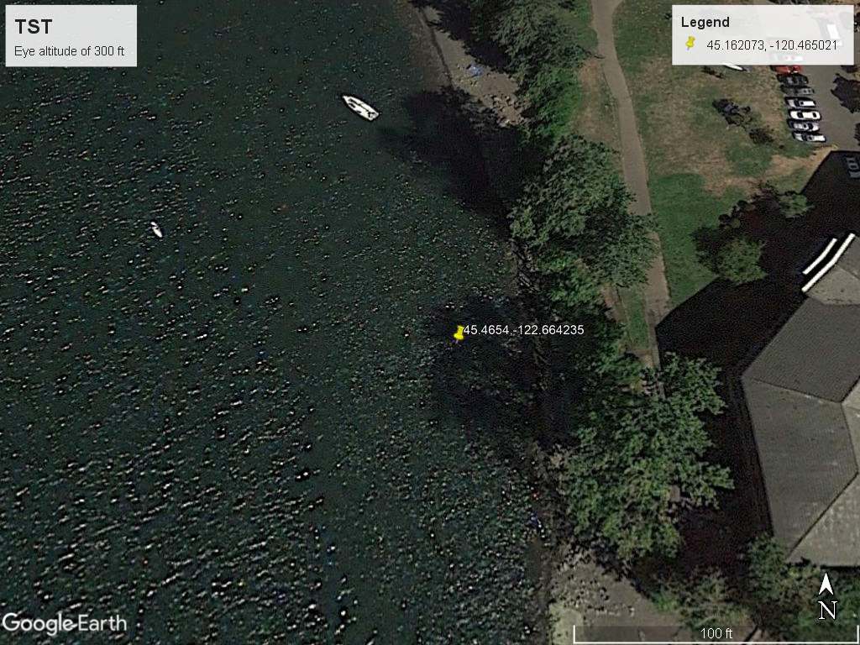
Site Code TST | Config. Number 100 | Surveyors Initials NJT
Site Name Test Site |  | Survey Date 8/2/2021
Approximate Low Water Line
Approximate High Water Line
01
02
03
Equipment Side
Flow

